Slide 1
Final Project School Meal Recognition
Group 6- EfFicientNet
陳泓穎 E24066496
傅立威 C24061088
李奕勳 E24064193
林韋辰 I54061233
游鎮嘉 N26091924

Slide 2
Outline
Why EfficientNet
How EfficientNet
Data preprocessing
Training progress
Testing result
Comparison
Duty splitting
Reference

Slide 3
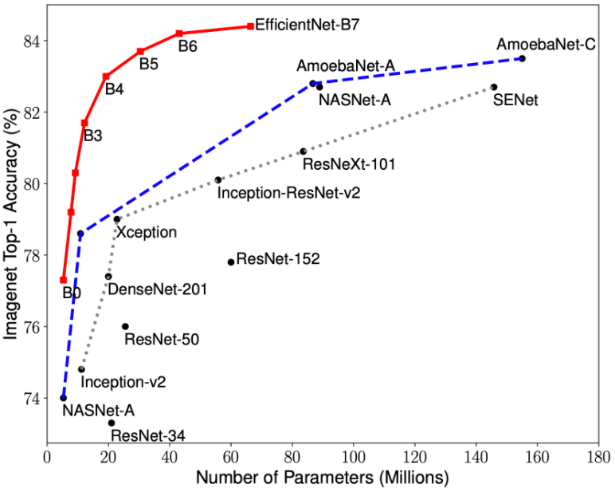
Why EfficientNet?
Higher accuracy and smaller, faster model!
Notes:
EfficientNets are a family of image classification models, which achieve state-of-the-art accuracy, yet being an order-of-magnitude smaller and faster than previous models.

Slide 4
How EfficientNet?
Compound Scaling
The EfficientNet Architecture

Slide 5
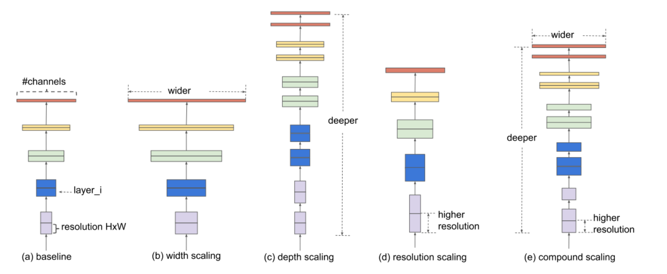
How EfficientNet? - Compound Scaling
Notes:
most common way to scale up ConvNets was either by one of three dimensions - depth (number of layers), width (number of channels(neurons)) or image resolution (image size)

Slide 6
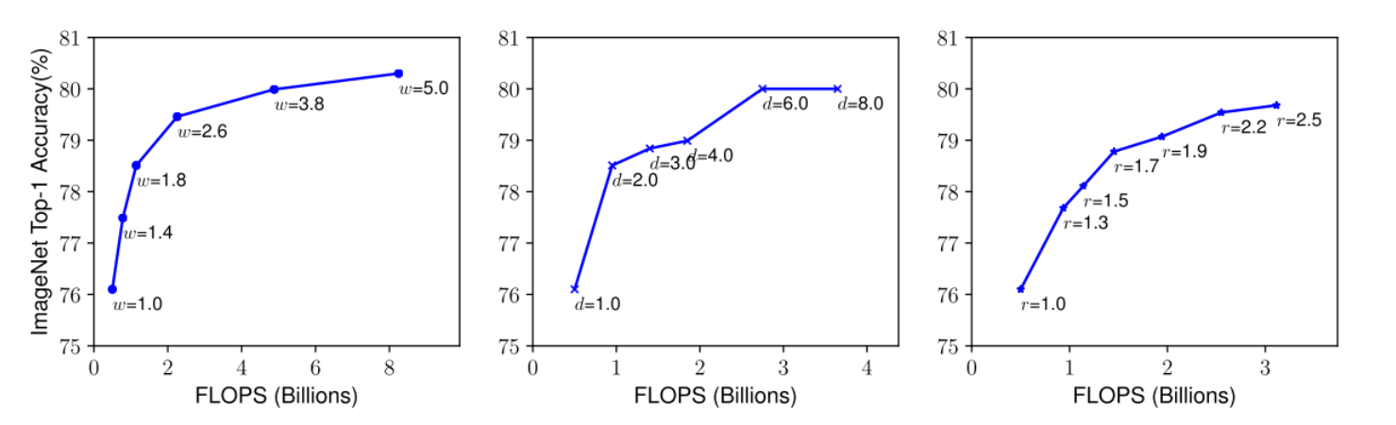
How EfficientNet? - Compound Scaling
Notes:
Scaling up any dimension of network width, depth, or resolution improves accuracy, but the accuracy gain diminishes for bigger models -> vanishing gradient problem

Slide 7
How EfficientNet? - Compound Scaling
Notes:
EfficientNets on the other hand perform Compound Scaling - that is, scale all three dimensions while maintaining a balance between all dimensions of the network. compound scaling makes sense too because if the input image is bigger (input resolution), then the network needs more layers (depth) and more channels (width) to capture more fine-grained patterns on the bigger image

Slide 8
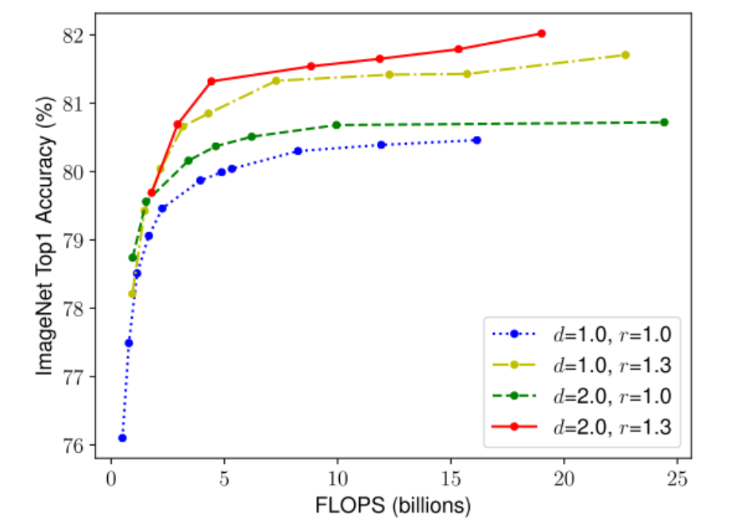
How EfficientNet? - Compound Scaling
Notes:
為了證明Compound scaling對於model的準確率提升真的有幫助，在paper中作者也做了許多實驗，圖表中是不同d(dimension)和不同r(image resolution)所對應到的accuracy，可以看到同時等比例提升d和r的準確率確實比較高。

Slide 9
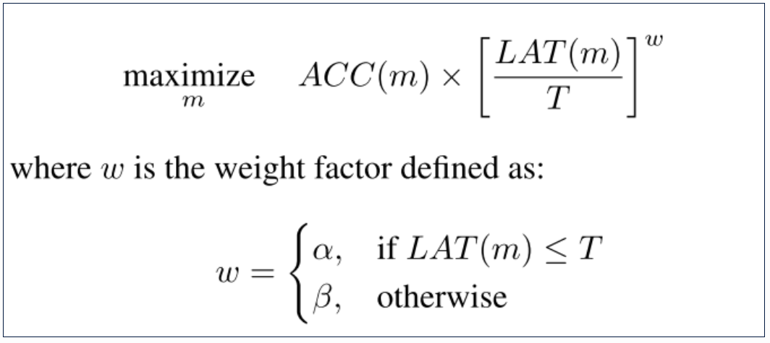
How EfficientNet? - EfficientNet Architecture
Neural Architecture Search
Notes:
有了scaling的方法，現在就差確立base model了，為了達到高準確率和低運算複雜度，EfficentNet用了一個技巧來建立模型架構-Neural Architecture Search，簡單來說就是透過參數的變化，來找到最佳化目標函數的架構，而這個目標函數的目的就是讓(準確率*運算複雜度)達到最大值
Find to base model(B0) that maximize the objective function，B1~B7 are the compound scaling result of B0
ACC – accuracy
LAT – FLOPS(computational complexity)

Slide 10
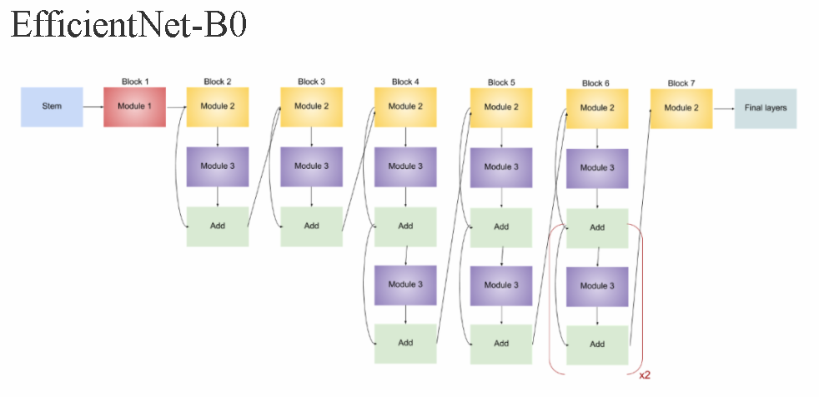
How EfficientNet? - EfficientNet Architecture
Notes:
透過Neural Architecture Search得到的架構即為EfficientNetB0，而EfficientNet家族有B0到B7，B1到B7就是基於B0做不同程度的compound scaling得到的結果。

Slide 11
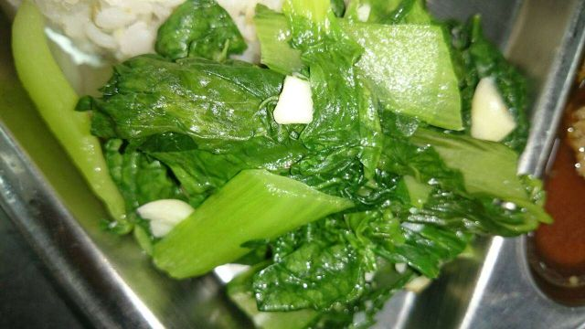
Data preprocessing- Resize
640
224
360
224
Notes:
EfficientNet input size (224,224)

Slide 12
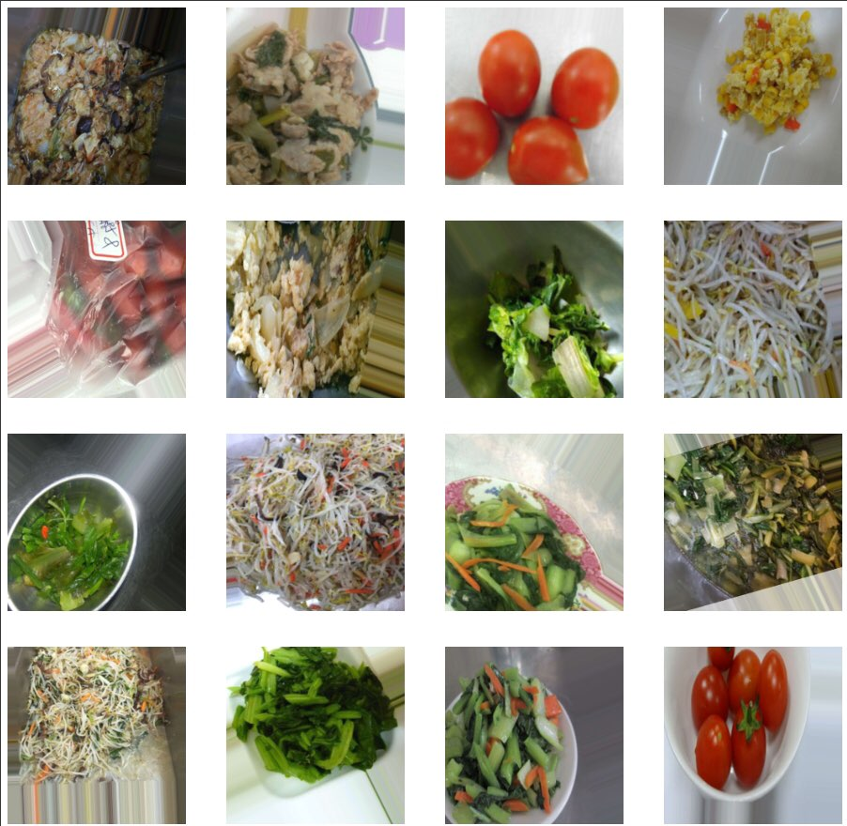
Data preprocessing- Augmentation
Notes:
Augmentation包含了垂直水平位移、shear、水平翻轉、聚焦等等…
width_shift_range=0.2,height_shift_range=0.2,shear_range=0.2,zoom_range=0.2, channel_shift_range=10,horizontal_flip=True,

Slide 13
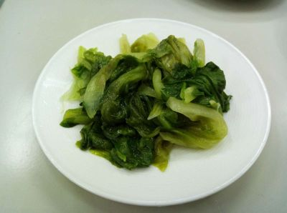
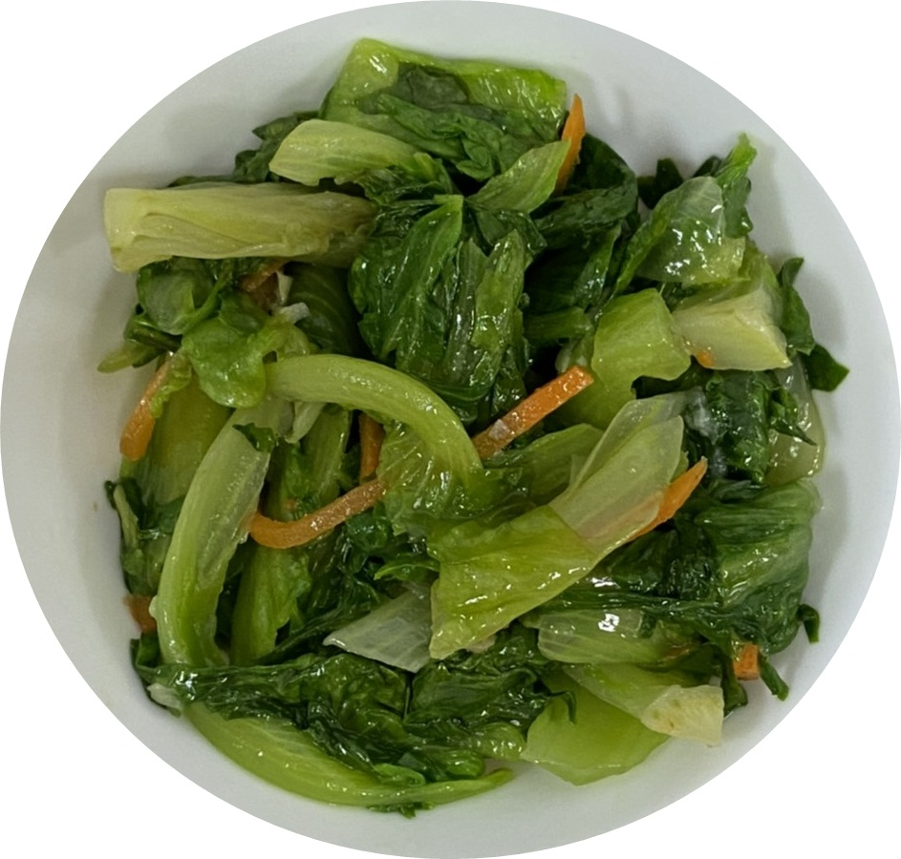
Data preprocessing- Too similar data
福山萵苣
大陸妹
Notes:
在檢視training data時，發現在不同類別的圖片中，有許多相似(近親品種、長相類似)的菜品，我們後來分成兩種data set去訓練，一種是保持原狀，另一種則是合併相似資料集去訓練，後面有兩者的比較

Slide 14
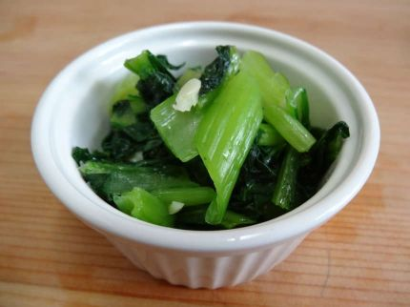
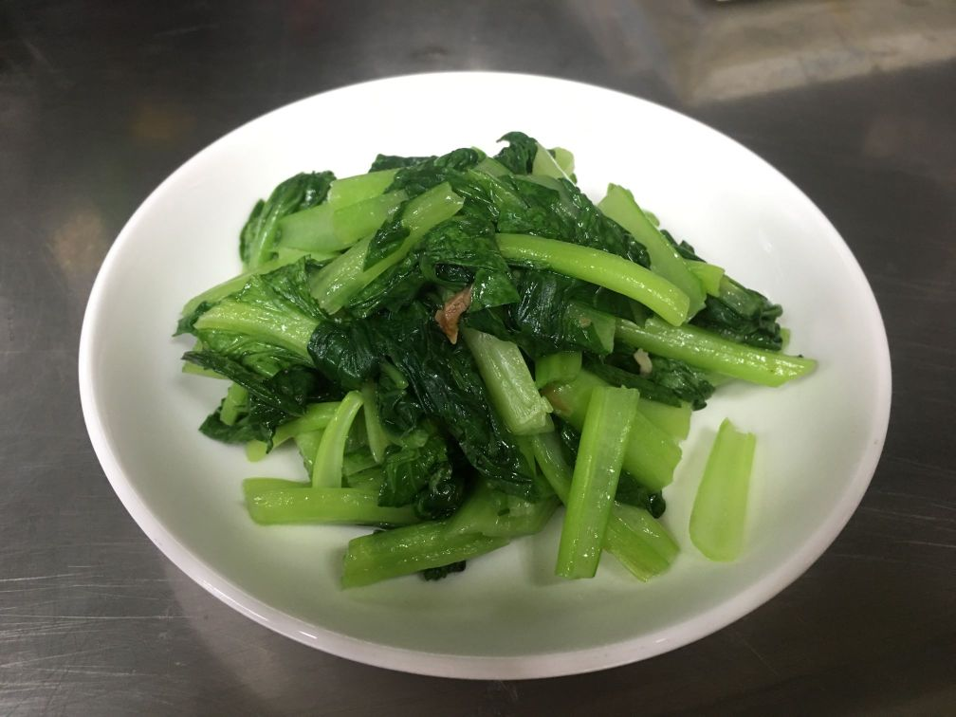
Data preprocessing- Too similar data
有機小松菜
油菜

Slide 15
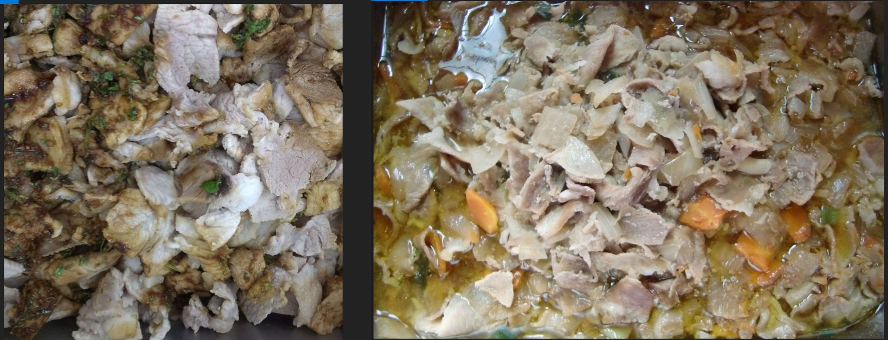
Data preprocessing- Too similar data
蒜泥白肉
沙茶肉片

Slide 16
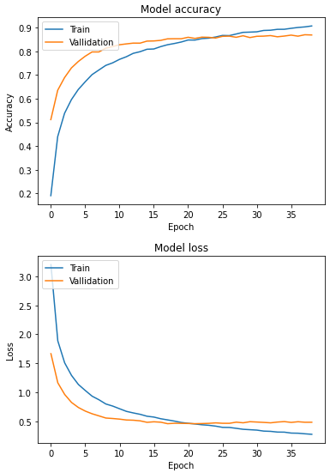
Training progress – EfficientNetB7
Notes:
經過訓練結果比較，我們訓練出來最好的model為EfficientNetB7

Slide 17
Testing result – Top accuracy
EfficientNetB7 | Top 1 accuracy | 87.45%
 | Top 5 accuracy | 98.69%
Top 1 accuracy : 87.45%
Notes:
Total 54 epochs

Slide 18
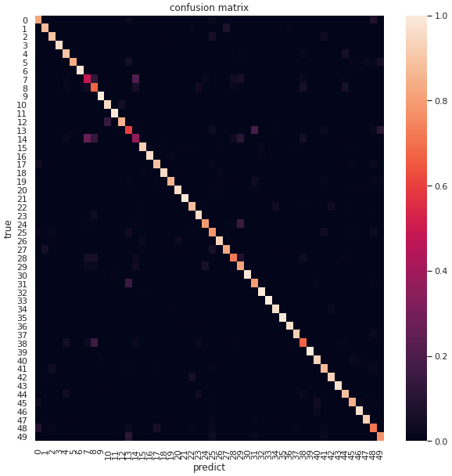
Testing result – Confusion matrix
7:有機小松菜
14:油菜
Notes:
Y軸為true label，X軸為我們predict的結果，可以發現所有50個種類都能準確地預測，而且都有不錯的準確率，圖中在對角線以外有一些亮點，就是因為兩種類別太過相似，而導致model有誤判的情形，

Slide 19
Comparison
EfficientNetB4 and EfficientNetB7
Freeze layer and not
Merge similar data or not

Slide 20
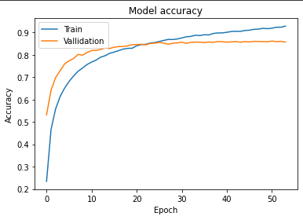
EfficientNetB4 and EfficientNetB7
EfficentNetB4
EfficentNetB7
Notes:
因為B7網路深度較深，所以訓練較少epochs就能達到不錯的accuracy

Slide 21
EfficientNetB4 and EfficientNetB7
EfficientNetB4 | Top 1 accuracy | 84.46%
 | Top 5 accuracy | 98.70%
EfficientNetB7 | Top 1 accuracy | 87.45%
 | Top 5 accuracy | 98.69%
Top 1 accuracy : 87.45%
Notes:
B7 performs better at Top 1 , B4 performs better at TOP 5

Slide 22
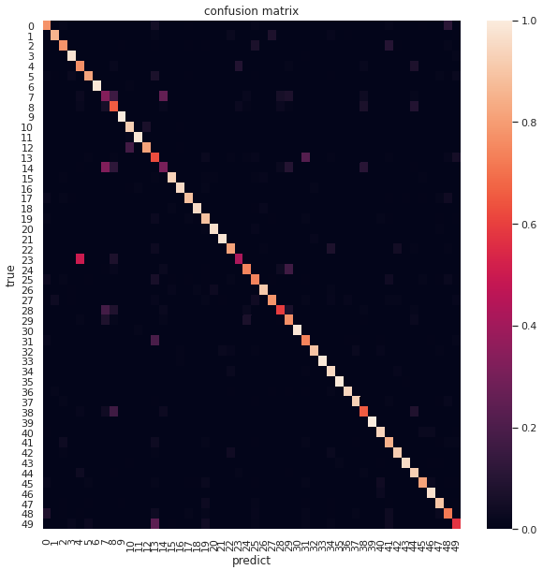
Testing result – Confusion matrix
EfficentNetB4
EfficentNetB7
Notes:
B7在分辨相似資料集上有更好的準確率

Slide 23
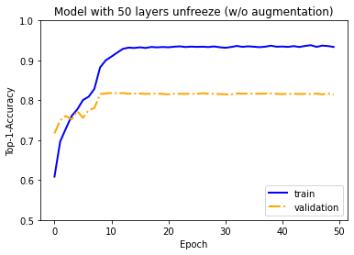
Freeze layer and not
Unfreeze only last 50 layers
Unfreeze all layers
Notes:
比較的結果滿符合理論與直覺，unfreeze all layers得到的結果更符合訓練集，預測的結果更好

Slide 24
Freeze layer and not
Unfreeze only last 50 layers | Top 1 accuracy | 81.82%
 | Top 5 accuracy | 97.80%
Unfreeze all layers | Top 1 accuracy | 87.45%
 | Top 5 accuracy | 98.69%
Top 1 accuracy : 87.45%
Notes:
Unfreeze all layers performs better at both TOP 1 and TOP 5

Slide 25
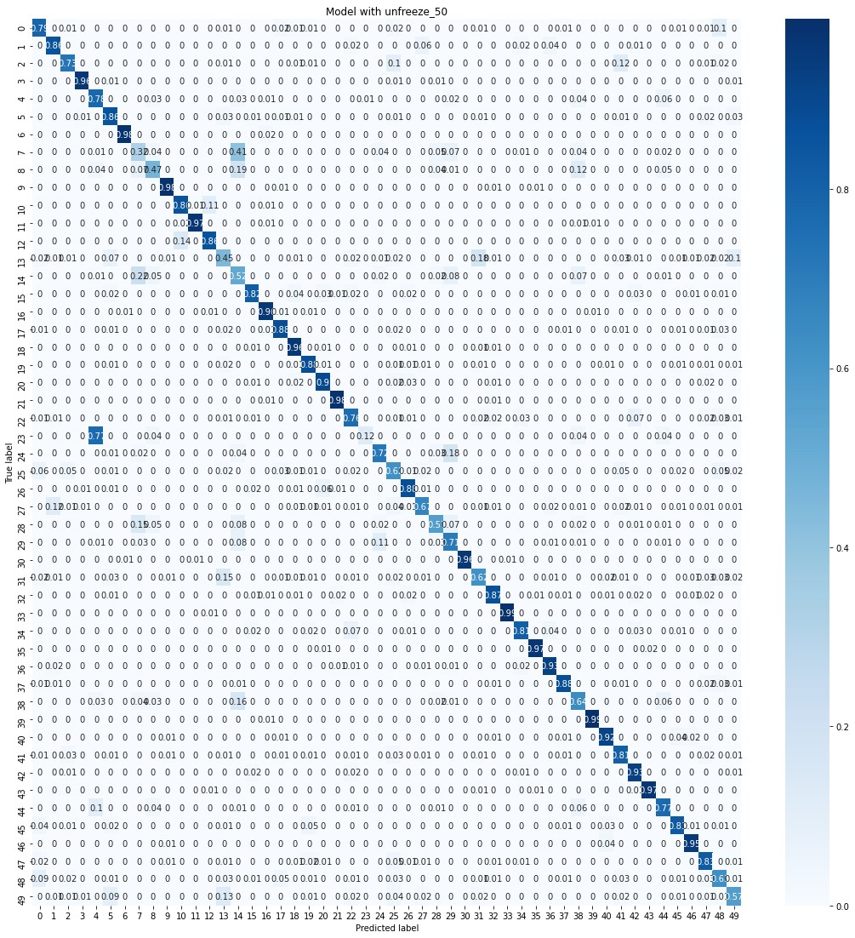
Testing result – Confusion matrix
Unfreeze only last 50 layers
Unfreeze all layers
Predict error on
大陸妹&福山萵苣
Notes:
Unfreeze all layers在分辨相似資料集上有更好的準確率，Unfreeze only last 50 layers 在分辨大陸妹和福山萵苣時會有錯誤

Slide 26
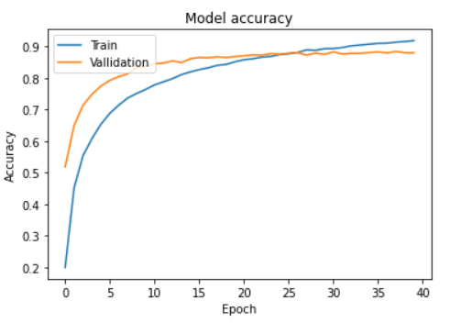
Merge similar data or not
Merge similar data
No merge similar data
Notes:
B7 performs better

Slide 27
Merge similar data or not
Merge similar data | Top 1 accuracy | 88.42%
 | Top 5 accuracy | 99.03%
No merge similar data | Top 1 accuracy | 87.45%
 | Top 5 accuracy | 98.69%
Top 1 accuracy : 87.45%
Notes:
Merge similar data performs better at both TOP1 and TOP5

Slide 28
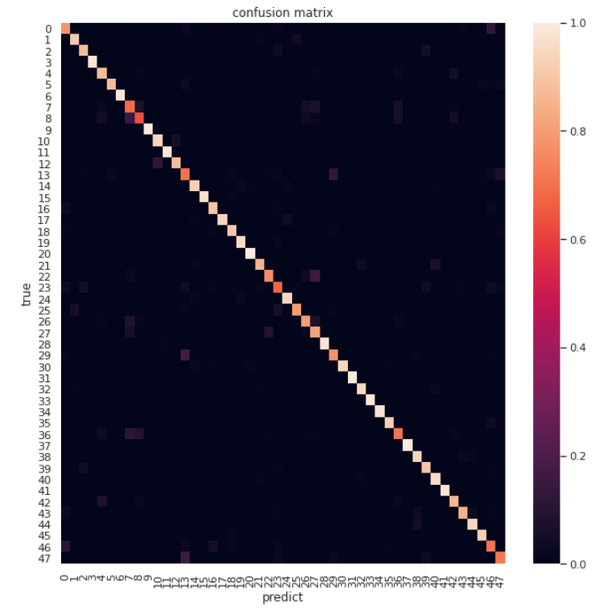
Testing result – Confusion matrix
Merge similar data
No merge similar data
Notes:
Merge data過後，可以在confusion matrix上發現，除了對角線上，幾乎沒有其他的亮點，可見merge的data特徵和長相真的很相似

Slide 29
Duty splitting
陳泓穎 – Coding (training B4 and B7 model without freezing layers)
傅立威 – Data washing and Coding (training B4 and B7 model with merging too similar data)
李奕勳 – Data washing 、 PTT making and paper survey
林韋辰 – Data washing and Coding (training B4 and B7 model with freezing layers)
游鎮嘉 – Data washing 、 report representation and video recording

Slide 30
Reference
https://iter01.com/533367.html
https://arxiv.org/abs/1905.11946
https://github.com/tensorflow/tpu/tree/master/models/official/efficientnet

